Slide 1
Responsive Image Gallery
HTML & CSS Project
Viva & Exam Presentation

Slide 2
Abstract
This project focuses on creating a responsive image gallery using HTML and CSS.
CSS Grid is used to adjust images automatically based on screen size, providing a clean and modern UI.

Slide 3
Objective of the Project
• To design a responsive image gallery
• To understand CSS Grid layout
• To apply hover effects using CSS
• To improve front-end design skills

Slide 4
Technologies Used
• HTML5 – Structure of the webpage
• CSS3 – Styling and layout
• CSS Grid – Responsive design
• Hover effects – User interaction

Slide 5
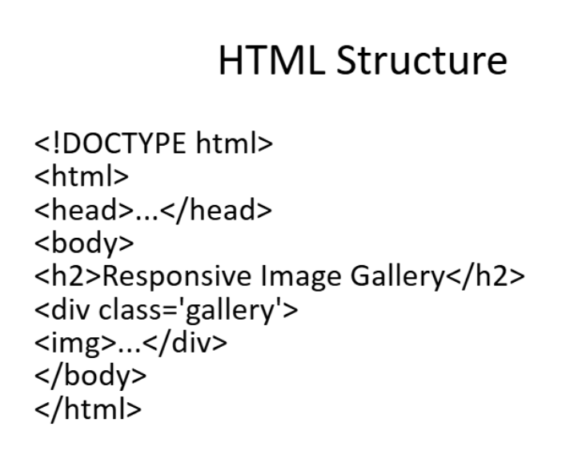
HTML Code Explanation
• <div class='gallery'> acts as the container
• <img> tags are used to display images
• Semantic HTML improves readability
• Easy to maintain and modify

Slide 6
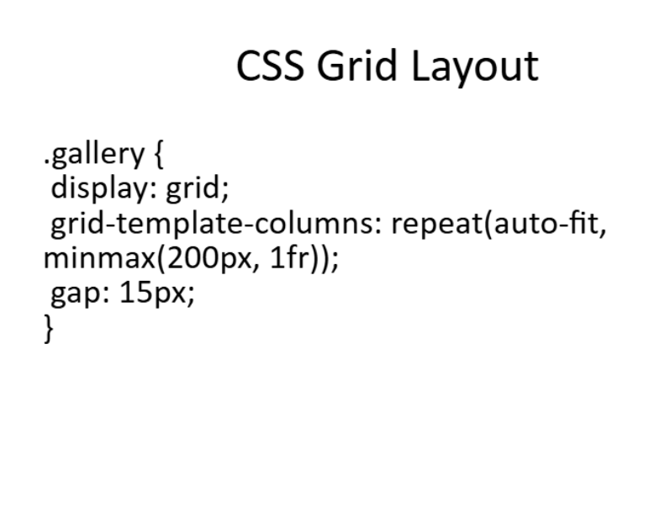
CSS Code Explanation
• display: grid is used for layout
• auto-fit adjusts columns automatically
• minmax ensures responsiveness
• box-shadow & border-radius enhance UI

Slide 7
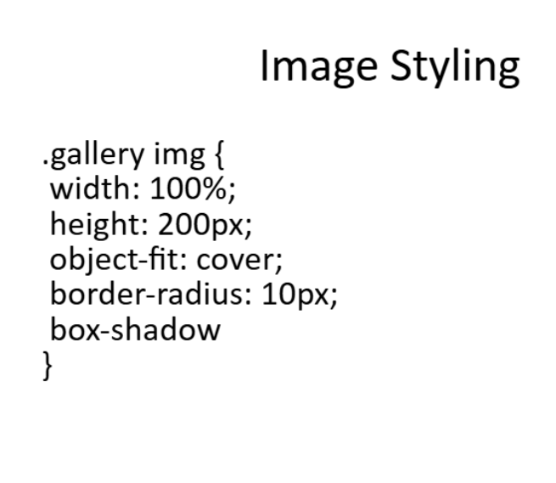
Sample Image Gallery
Sample images are displayed in a grid format.
Images resize automatically and maintain aspect ratio using object-fit: cover.
Hovering over images provides a smooth zoom animation.

Slide 8
Advantages
✔ Fully responsive
✔ User-friendly interface
✔ Modern web design
✔ Easy customization
✔ Lightweight and fast loading

Slide 9
Applications
• Portfolio websites
• Photo galleries
• Blog websites
• E-commerce product displays

Slide 10
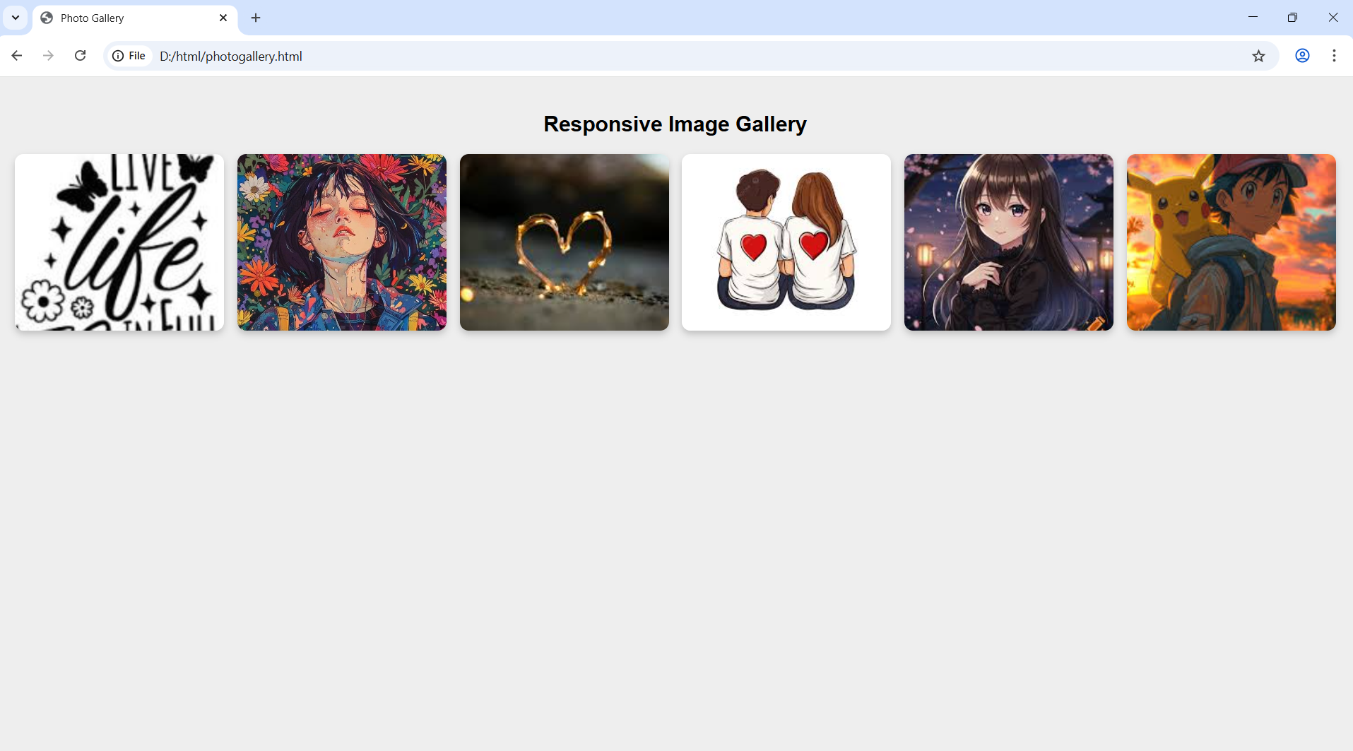
OUTPUT SCREENSHOT

Slide 11
Conclusion
Thus, the responsive image gallery is successfully created using HTML and CSS.
This project helps in understanding responsive layouts and modern web design techniques.

